Slide 1
Identity
Project Brief
In this project you will be exploring the theme of identity using photography.
Using photography, what story can you tell about yourself or someone else?
You’re to research the work of other photographers to help inform your work. You’re to create a series of experimental images that will support a final piece.
Deadline -
How you’re marked
AO1 (Develop)
Find relevant photographers to look at
Make personal comments about their work
Visit galleries/museums/locations/etc
Use this work to inspire you
AO2 ( Experiment)
Use different techniques and processes (lighting, camera angles, models, locations..)
Experiment with presentation/manipulation(photoshop
Evaluate and reflect on experiments
AO3 (Record)
Take a wide range of your own photographs
Annotate your work
Illustrate/screenshot/document
AO4 (Present)
Produce a confident and high
quality final piece(s)
Ensure your work links to your
prep and research.
This is 60% of your GCSE grade.
This is 60% of your GCSE grade.

Slide 2
AO1 | AO1 | AO1/AO3 | AO1/AO3 | AO1/AO3 | AO2 | AO2 | AO2 | AO2/AO3 | AO2 | AO2/AO3 | AO2 | AO3/AO4 | AO4 | AO4/AO3
Identity Mindmap | Mood board ideas | Alison Diaz - 150 Words | Alison Diaz recreation | Sophie Calle - 150 words | Sophie Calle/Possessions images | Written/ Visual ideas and plan for a photo shoot | Series of 20+ images from photo shoot | Annotated contact sheets - refine | Second photo shoot | Reflection - Selection Process | Explorations in presentation | Final Piece Plan | Final piece | Evaluation

Slide 3
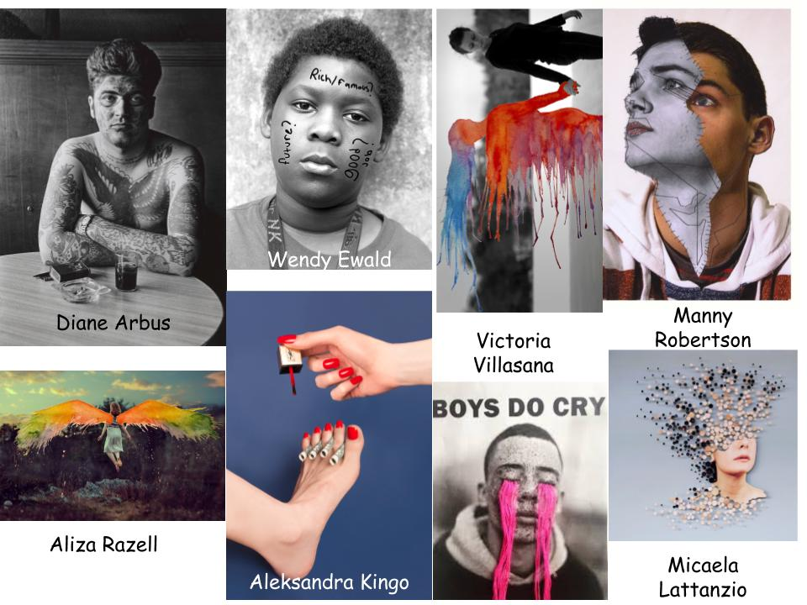
Select a photographer of your choice that relates to ‘Identity’. Collect 3 examples of one photographers work.
Examples are attached for your inspiration.

Slide 4
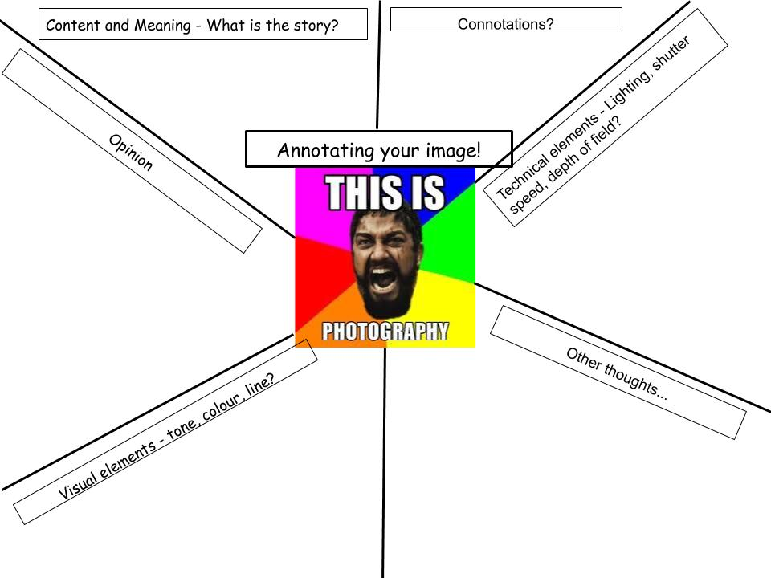
In full sentences please analyse your chosen imagery.
On the following sheet is a writing frame to support you to start this.

Slide 5
Photographer Analysis
Paragraph 1
_____(Photographers Name)______________ is a ________________ photographer. He/She takes images of_______________________________________________
He/She explores themes of______________________________________________
The parts I enjoy most about this photographer are _________________________because_____________________________________________________.
Paragraph 2
What comment is the photographer making about identity? How are they doing this?
What mood/feeling is explored in your image?
What are the connotations in your image?
Paragraph 3
What formal elements stand out to you the most? Colour, line, shape, tone, composition, contrast?
How do these effects strengthen the visual elements in this image?
What effect or mood do these elements have?

Slide 6
All of you are at different stages and doing different projects.
Once you have analysed your chosen photographer that represents ‘Identity’ to you….
Create a plan of what you would like to photograph.
Limitations may apply, but, consider what images you could take within your home with your camera phone.
Your possessions?
Your friends/guardians/loved ones?
The current climate and how this changes the identity of your life?

Slide 7
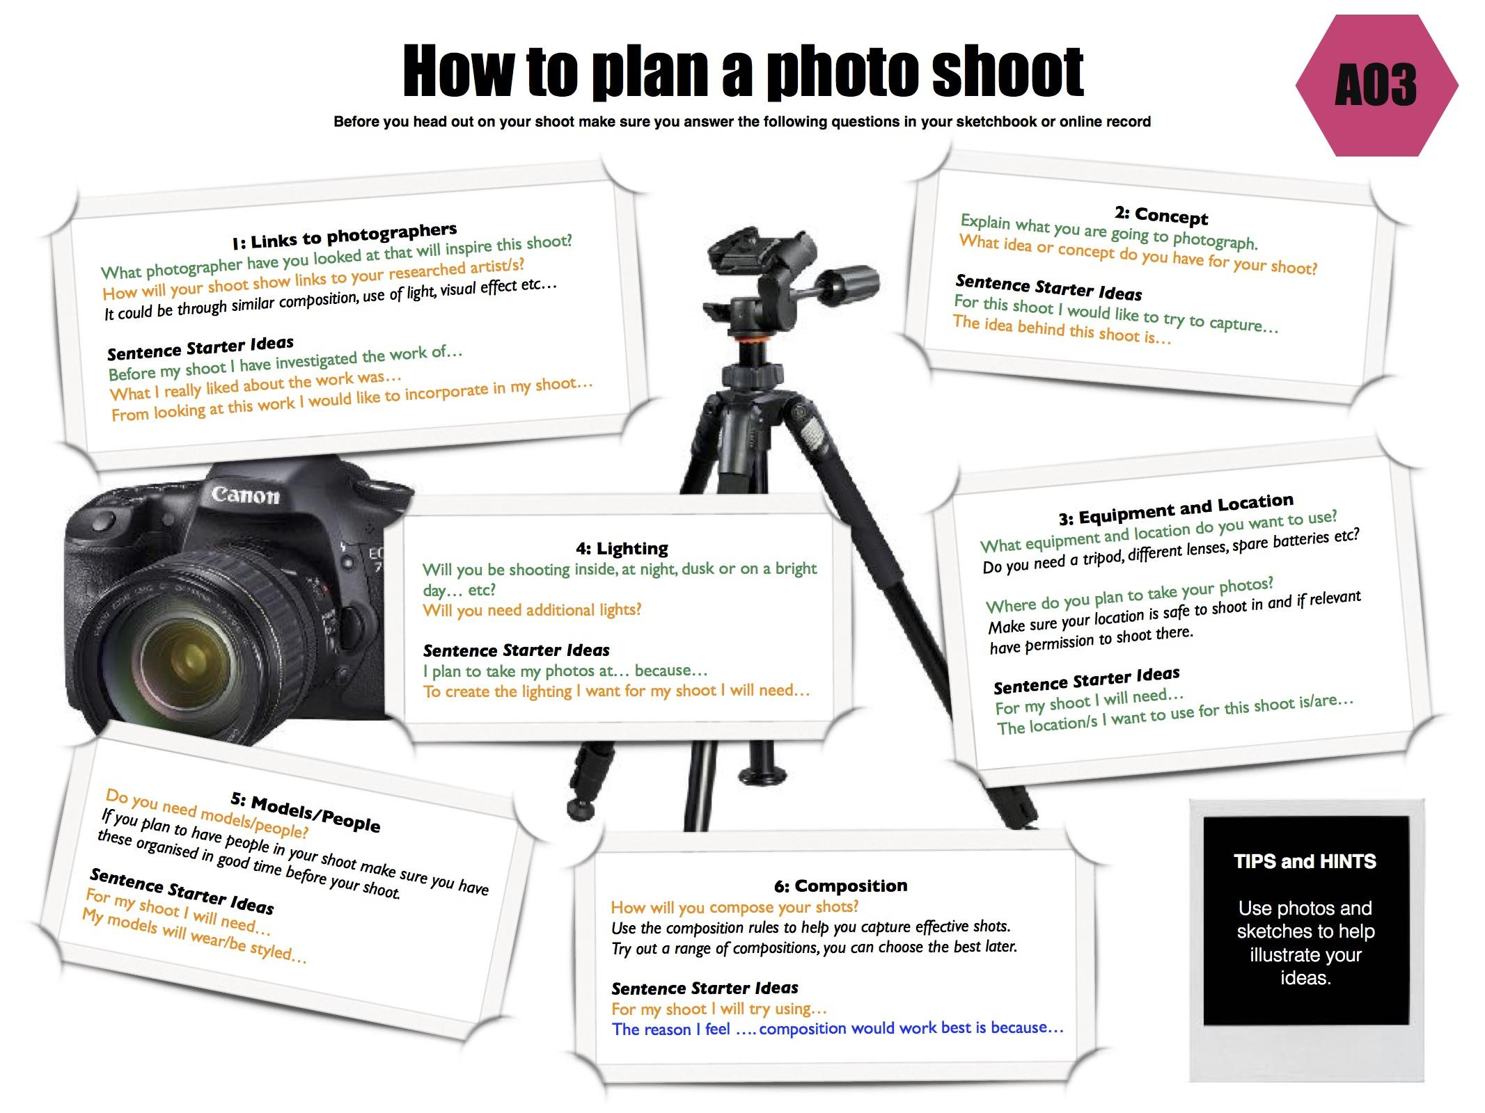
Things to consider for your photoshoot…
- How it links to your chosen photographer
- Equipment
- Location
- Lighting
- Models/People
- Composition/
Camera angles.

Slide 8
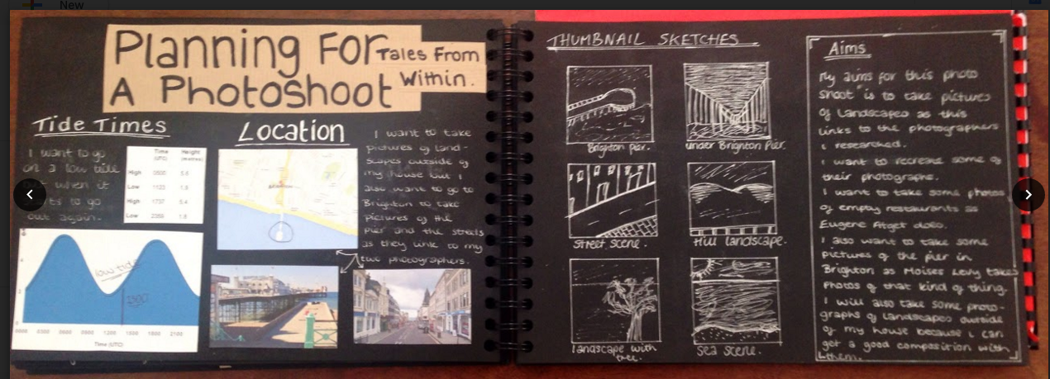
An example of what your plan could look like….
You can do this digitally or by hand, whichever way you work best!

Slide 9
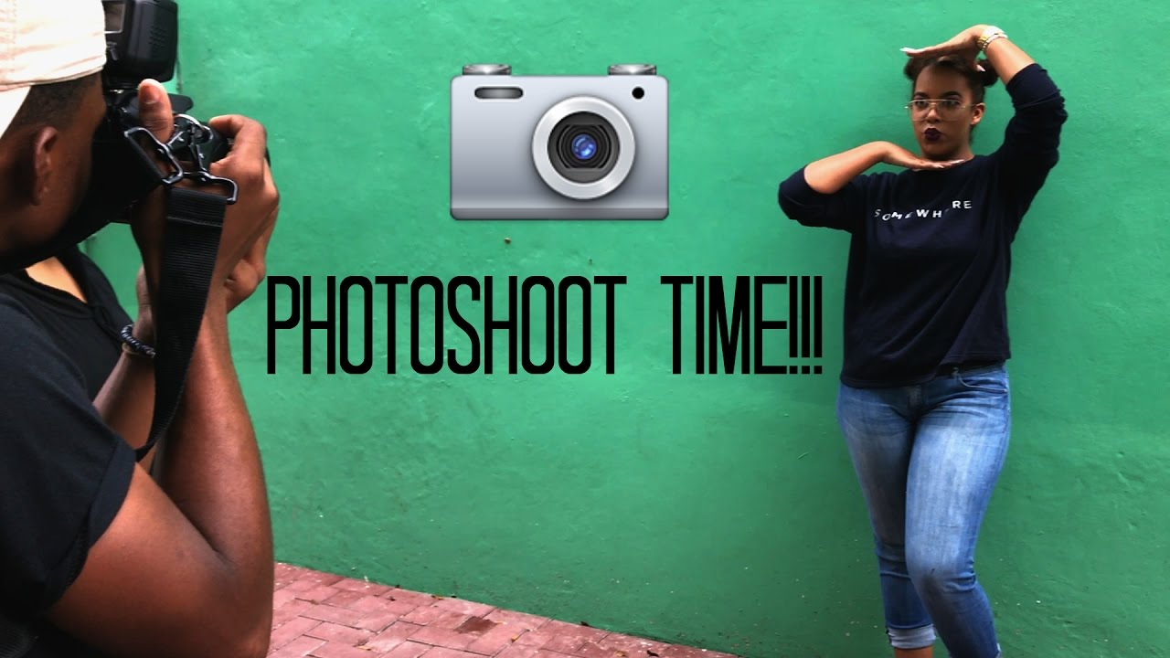
Using your camera phone take some images that link to your project. These don’t have to be perfect. Think of these images as your ‘sketches’ before creating your final piece.
You can insert images onto your Drive by emailing the images to yourself if you have data.
If not….use your images on your phone to analyse on a
Remember…
Focus
Composition
Colours
Camera angles

Slide 11
Insert Contact sheet and/or annotations here…
Remember….
I am always contactable by email.
sally.croft@stonesouplearns.com
Stay safe and be kind to each other.
:)
Six dojos for anyone that can solve this riddle...
What can’t talk but will reply when spoken to?

