Slide 1
Creating a Final Piece.
Following on from the previous pack….you should already be armed with your plan of what you want to do for your final piece. This shall be hitting Assessment Objective 4. Your final piece can take any form you want it to, it just has to continue from the same theme/style/thoughts you’ve been exploring and link to your research, even if this is vaguely!
Remember to have fun when creating images for your final piece. You can combine found images too or images you’ve already got at home too!

Slide 2
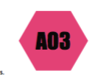
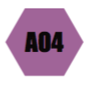
Step Eight….
The first step to your final piece is taking the photographs for it!
I always recommend taking at least 25+ images and then uploading to your drive or creating a contact sheet on www.piccollage.com. This way you have more images to choose from as not all of your photographs are going to be good!
Even professional photographers take lots of images before they find the right one.
Most importantly….have fun! Your final piece is about you and what you love! :)

Slide 3
Step Nine….
You got that right! Annotate that contact sheet!
This time you’re thinking what final images could work together?
Why would they work together?
How many final images would I like? Why?

Slide 4
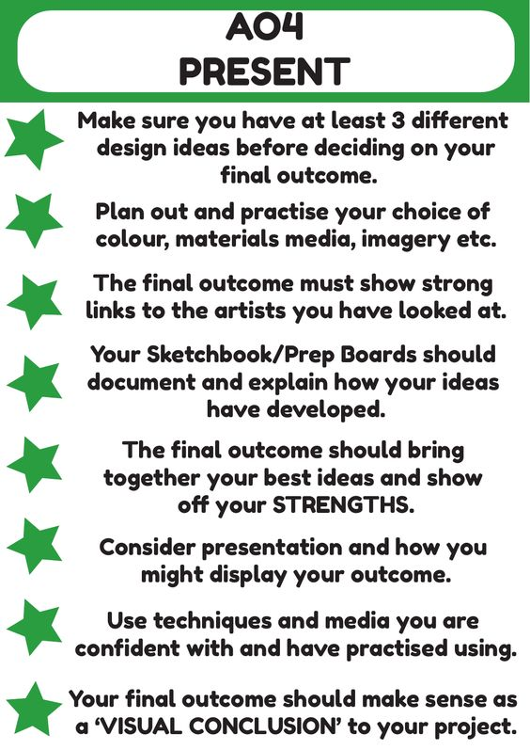
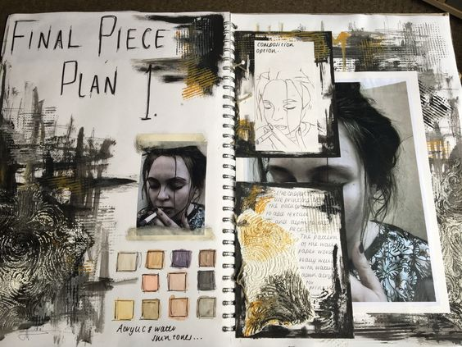
Step Ten….
So you’ve got your final images selected! That’s fantastic! To be achieving higher grades, I would also recommend planning out how you might want to present your imagery. Maybe plan a couple of ideas before deciding on the final one. I’ve put some presentation ideas on the next page….

Slide 5
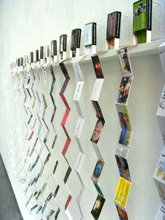
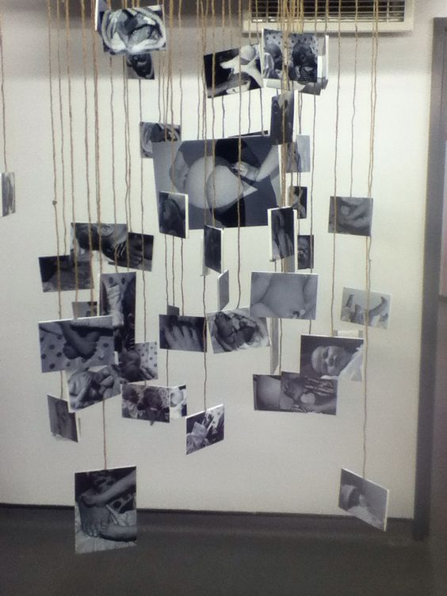
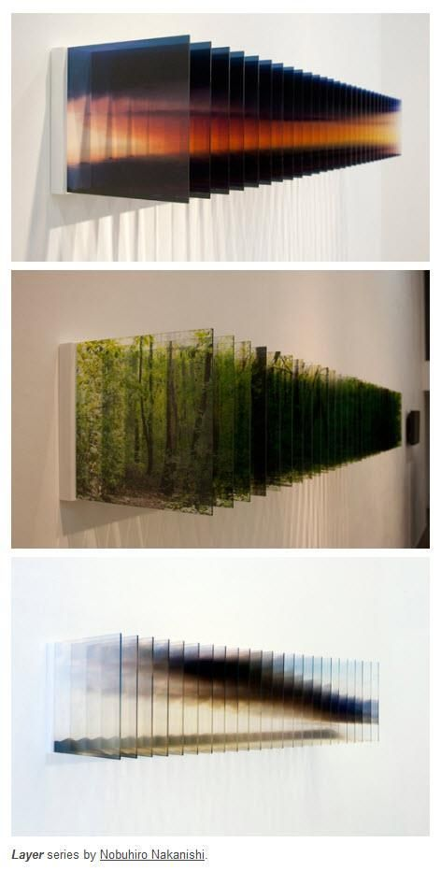
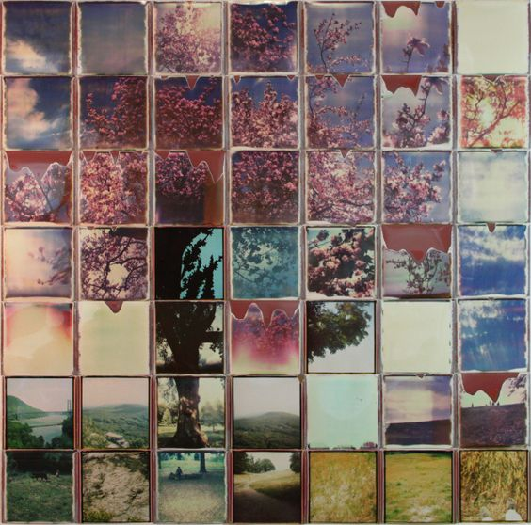
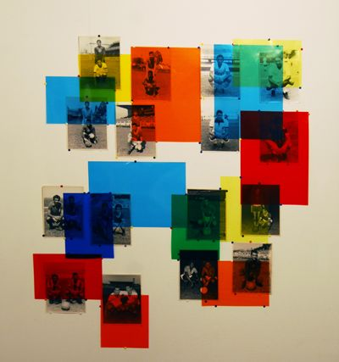
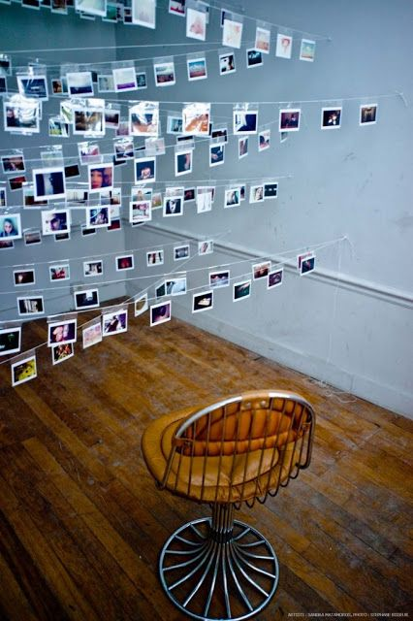
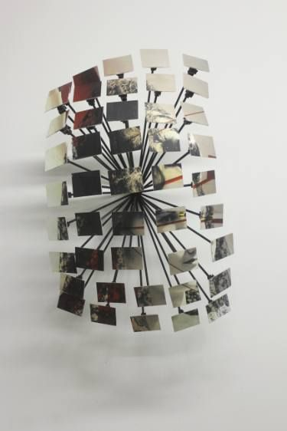
Final Piece Presentation Ideas
Remember this is a plan! I appreciate you might not have materials to make this happen at home.
If materials aren’t at home - simply arrange your final images onto a presentation online and we can print when needed.

